Slide 1
Introduction to Data Science
> Final Project Proposal
Members:
Mohsin Aslam - 15157
Mudassir Ali Baig - 15164
Wajih Siddiqui - 15153

Slide 2
Problem statement
“Determine factors that lead to employee attrition and explore important questions such as Showing a breakdown of distance from home by job role and attrition”
Compare average monthly income by education and attrition.
Why are the best and most experienced employees leaving prematurely and try to predict which valuable employees will leave next?

Slide 3
Data Sources to be Used
IBM HR Analytics Employee Attrition & Performance
HR data from an organization whose details are anonymize with similar attributes that correspond to employee attrition
Datasource: https://www.kaggle.com

Slide 4
Integration of Data Sources
Both datasets contain features that relate to employee attrition
Combine both datasets, keep common features
Enumerate similar columns for compatibility
Deal with missing values i.e intersection of features
Determine unknown features like employee age, expected salary, rank where required
Common Feature
IBM HR Analytics
XYZ HR Analytics

Slide 5
Analysis Planned
Analyze the data and perform data preprocessing in order to shape up the data for particular model.
Perform exploratory data analysis to find the initial correlations within the dataset and visualize it.
Perform multiple classification algorithms like Random Forest, Logistic Regression for employee churn rate.
Iteratively applying the algorithm with changes in preprocessing steps and changes in the parameters of the model to obtain the best accuracy for the employee attrition.
Determine strategies for HR to hire employees on this model.
Choose the model with best accuracy from a number of classification models.

Slide 6

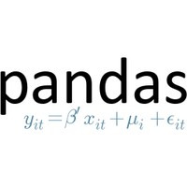


Tools
IPython
Pandas
Scikit Learn
Seaborn
Numpy
Matplotlib
Flask
AngularJS

Slide 7
Progress Update
Over-Sampling (SMOTE) Synthetic Minority Over-sampling for the dataset of IBM
Determined correlations amongst all dimensions of both datasets
Interconversion of Numeric and Categorical values for EDA
Observed correlations and distributions by visualizations including Scatter pairwise plots, Heatmaps, histograms (Matplot lib and Seaborn)

Slide 8
Final Product Updates
Web Application to Predict the Employee Churn
APIs hosted that use the persisted model to determine churn
AngularJS form for providing data

Slide 9
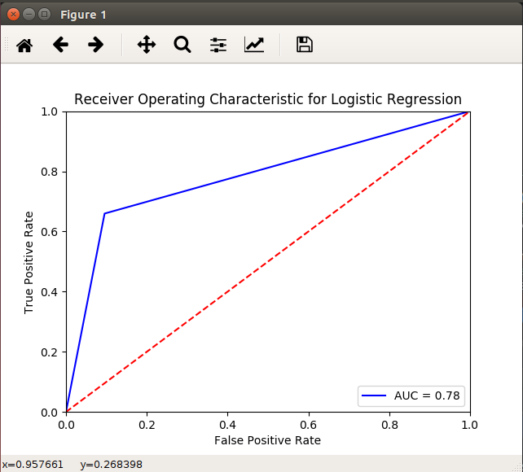
Logistic Regression
Applied logistic regression to the data after merging both Data Frames
Converted all values to numeric and categorical
Findings:
Accuracy is 78%
Precision: 0.81, Recall: 0.81, F-measure: 0.8
Model trained on 70% dataset and persisted with file ‘logistic.pkl’

Slide 10
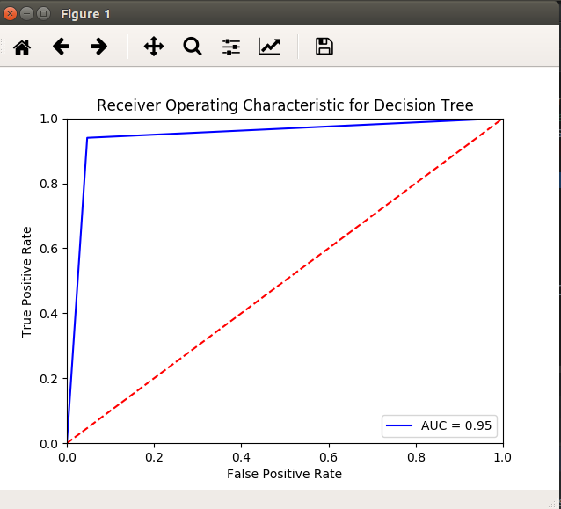
Decision Tree
Applied Decision Tree to the data after merging both Data Frames
Converted all values to numeric and categorical
Findings:
Accuracy is 95%
Precision: 0.95, Recall: 0.95, F-measure: 0.95
Model trained on 70% dataset and persisted with file ‘decision_tree.pkl’

Slide 11
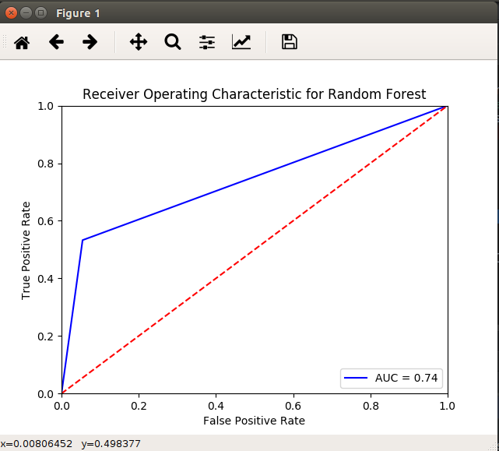
Random Forest
Applied Random Forest to the data after merging both Data Frames
Converted all values to numeric and categorical
Findings:
Accuracy is 74%
Precision: 0.8, Recall: 0.78, F-measure: 0.77
Model trained on 70% dataset and persisted with file ‘random_forest.pkl’

Slide 12
Conclusion on Selection of Classifier
Logistic Regression is the best candidate in this case as it gives a good accuracy
Decision tree gives a very high accuracy and it is overfit
Random Forest is also a good candidate
Based on all 3 Candidates the API’s will use Logistic Regression

Slide 13
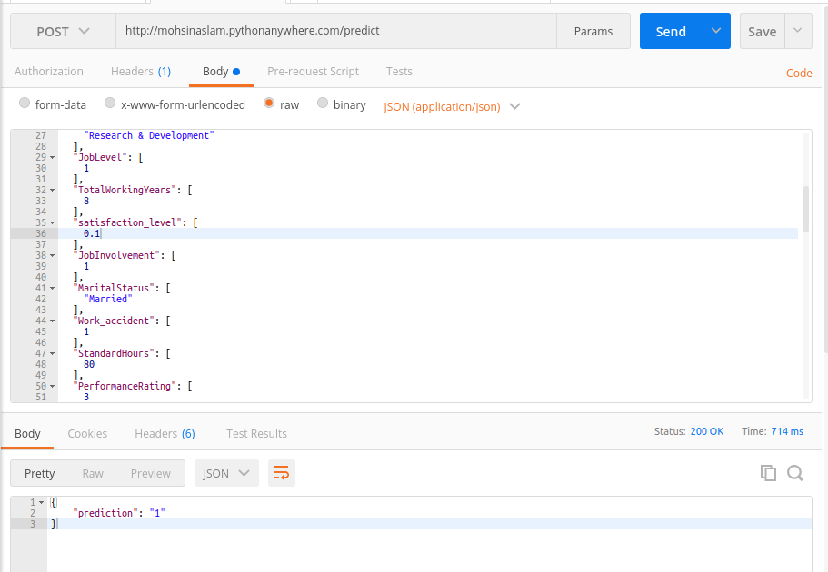
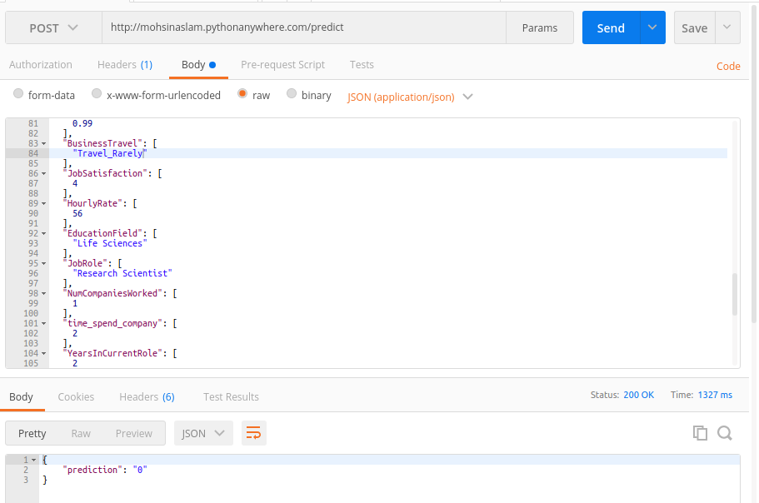
Testing through the Flask REST API

Slide 14
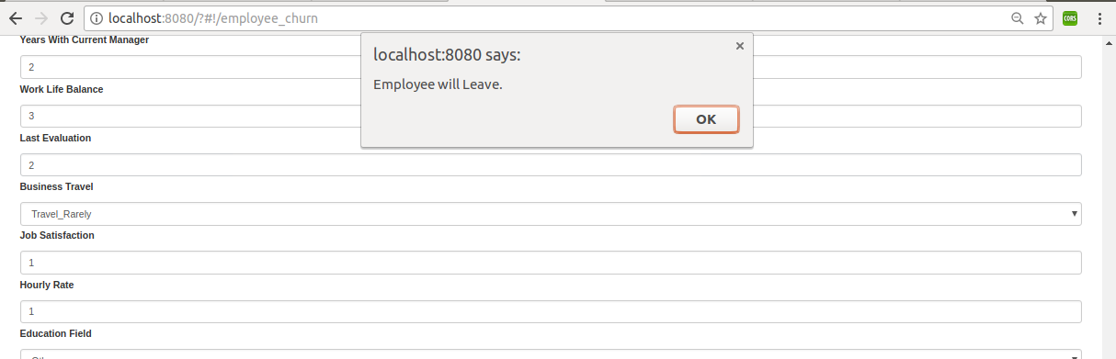
Testing through the AngularJS Website

Slide 15
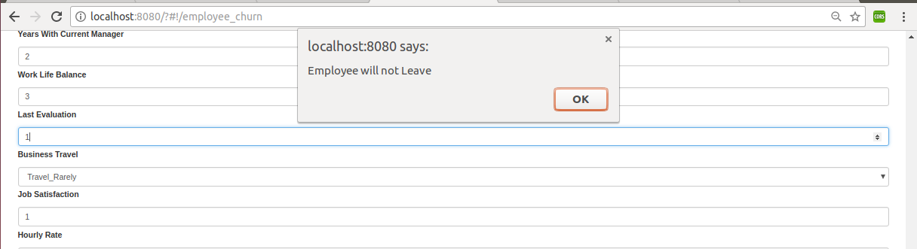
Testing through the AngularJS Website

Slide 16
Future Enhancements
Support bulk predictions rather than form (Not implemented due to Parsing restrictions)
Visualize data on website
Compare employee churn of two different employees

Slide 17
Thank you !!

